Slide 1
ANIMALS-10 Image Classification using Neural Networks
An Image Classification Project
BY
NISHANTH JS(NEC - CSE)

Slide 2
Table of contents
01
02
03
04
Introduction
Dataset and Approach
Model Architecture and Training
Results and Conclusion

Slide 3
01
INTRODUCTION

Slide 4
INTRODUCTION
Image classification assigns a label to an input image using machine learning.
It is applied in fields like healthcare, security and so - on.
Complexity arises due to pixel patterns, variations in lighting, angles, and backgrounds.
Class imbalance in datasets affects model performance.
The objective is to classify animal images from the ANIMALS-10 dataset into 10 categories.
The categories include animals like cats, dogs, elephants, etc.
A Multilayer Perceptron (MLP) neural network is used for classification.
The dataset is split into training and validation sets to improve model accuracy.

Slide 5
02
Dataset and Approach

Slide 6
Dataset and Approach
The dataset used is ANIMALS-10, containing 10 distinct animal categories.
Each category has images stored in separate folders within the main dataset folder.
Data preprocessing includes image normalization and augmentation for better training.
Image augmentation involves rotation, width shift, height shift, shear, zoom, and horizontal flip.
The dataset is split into training (80%) and validation (20%) to monitor model performance.
The neural network model is a Multilayer Perceptron (MLP) for image classification.
Input images are resized to 150x150 pixels for uniformity in model training.
Data is fed to the model in batches, improving memory efficiency during training.

Slide 7
03
Model Architecture and Training

Slide 8
Model Architecture and Training
The model is a Sequential Neural Network (Multilayer Perceptron).
Input layer accepts images of size 150x150 with 3 color channels.
Four convolutional layers are used to extract features from images.
MaxPooling layers reduce spatial dimensions after each convolution.
Flatten layer converts the 2D matrix into a 1D vector for the dense layers.
Dense layer with 512 neurons followed by a Dropout layer to prevent overfitting.
Output layer has 10 neurons with softmax activation for multiclass classification.
The model is compiled using Adam optimizer, categorical cross-entropy loss, and accuracy as the metric.
The model is trained for 50 epochs using training and validation datasets

Slide 9
04
Results and Conclusion

Slide 10
Results and Conclusion
Model achieved a high accuracy on the validation dataset after training.
Loss decreased steadily during training, indicating effective learning.
The final validation accuracy confirms that the model generalizes well to unseen data.
Some categories performed better due to more balanced data representation.
Future improvements could include data augmentation, fine-tuning hyperparameters, or using advanced architectures like CNNs for better performance.
The project successfully classifies animal images into 10 categories.
Potential real-world applications include wildlife monitoring and biodiversity research.

Slide 11
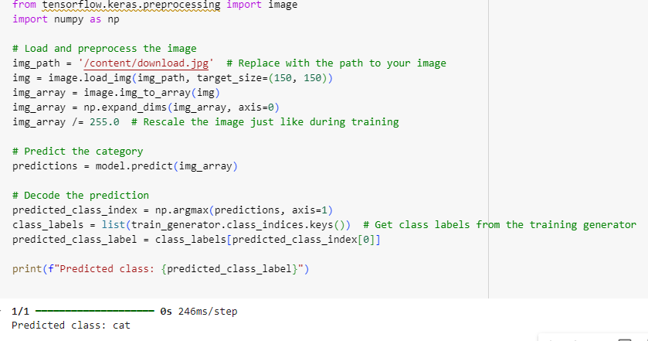
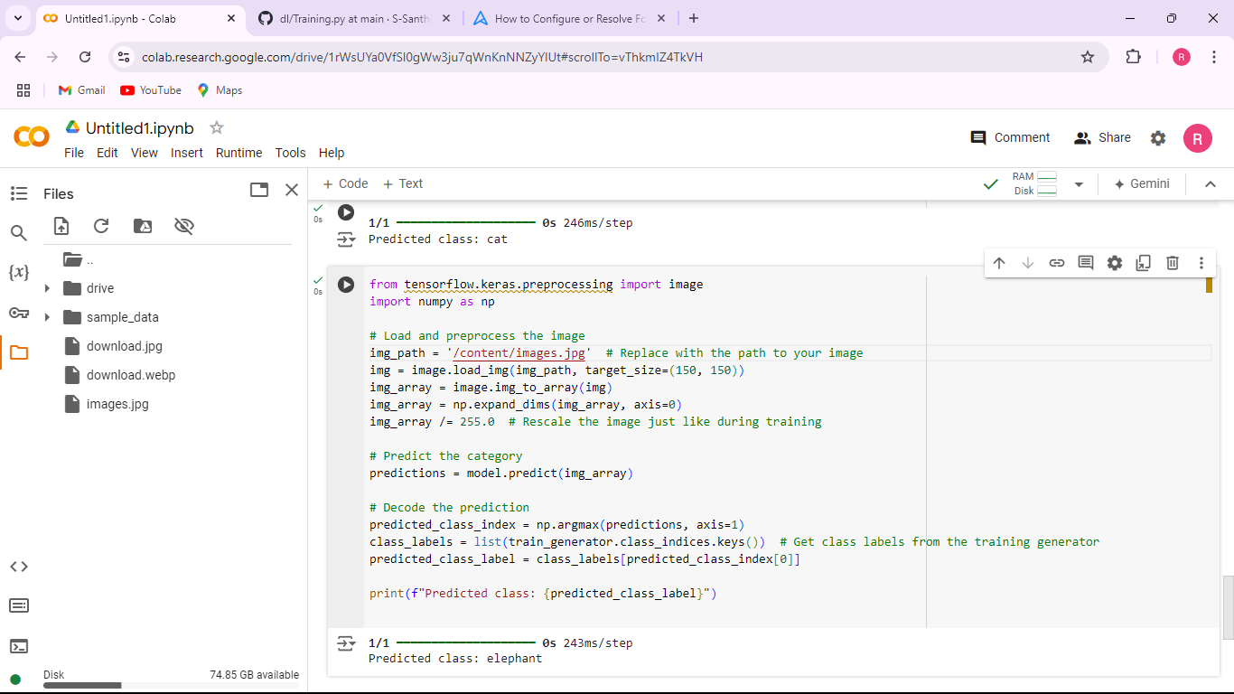
Output

Slide 12
THANK YOU

